Slide 1
MPCA LAB MINI PROJECT
PROJECT TITLE: “ Forest fire management system”.
SECTION: C
NAME SRN
1) Kunduru Ujwal → PES2UG19CS197
2) KIRAN BS → PES2UG19CS186
3) KOUSHIK P L → PES2UG19CS193
4) KAUSHIK T KUNDAR → PES2UG19CS179

Slide 2
PROBLEM STATEMENT
Detection and Management of Forest Fires.

Slide 3
INTRODUCTION
Forests are the protectors of earth's ecological balance. Unfortunately, the forest fire is usually only observed when it has already spread over a large area, making its control and stoppage arduous and even impossible at times. The result is devastating loss and irreparable damage to the environment and atmosphere (30% of carbon dioxide (CO2) in the atmosphere comes from forest fires) , in addition to irreparable damage to the ecology (huge amounts of smoke and carbon dioxide (CO2) in the atmosphere). Among other terrible consequences of forest fires are long-term disastrous effects such as impacts on local weather patterns, global warming, and extinction of rare species of the flora and fauna.
The following part presents a brief overview of automatic and semiautomatic detection and monitoring systems of fire protection in the world, experience with these systems in practical operation, and their evaluation in terms of efficiency, accuracy, versatility, and other key attributes

Slide 4
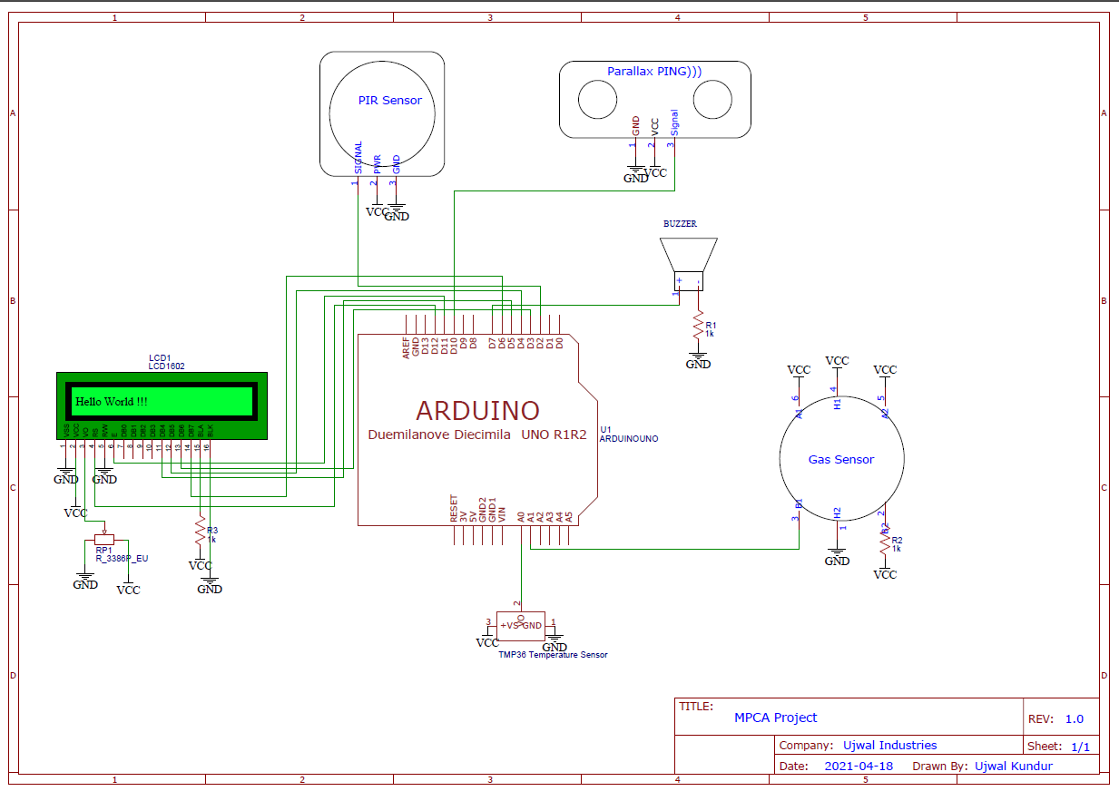
BLOCK DIAGRAM

Slide 5
REQUIRED COMPONENTS
Name | Quantity | Component
U1 | 1 | Arduino Uno R3
U2 | 1 | LCD 16 x 2
Rpot1 | 1 | 250 kΩ Potentiometer
R1 | 1 | 220 Ω Resistor
PIR1 | 1 | PIR Sensor
PING1 | 1 | Ultrasonic Distance Sensor [Parallax Ping]
U3 | 1 | Temperature Sensor [TMP36]
GAS1 | 1 | Gas Sensor
PIEZO1 | 1 | Piezo Buzzer
R2, R3 | 2 | 1 kΩ Resistor

Slide 6
PROJECT DESCRIPTION
This project focuses on quickly detecting forest fires and any related hazards such as falling trees, wood, etc.
A PIR motion sensor is used to detect motion such as falling trees, etc. it triggers an interrupt which uses the Ultrasonic Distance sensor to measure the distance to the falling object and Sounds a Peizo Electric Buzzer to Warn nearby Fire Fighters.
Without any motion, the appliance continuously monitors temperature and gas levels and sounds the piezo buzzer to alert people if smoke and temperature levels are above safe levels.

Slide 7
APPLICATIONS
Contribution to the forest fire fighting strategy, providing critical data to improve their safety and efficiency.
Provides valuable forest and climate parameters as input to the fire propagation models. This includes Temperature, Tree fall, Tree fall Distance, Smoke levels.
Early detection of forest fires, and real time reports about the fire spread. They provide alerts by integrating information from several nodes.
Nodes will not need any kind of maintenance or battery recharging. Energy harvesting techniques and an optimized low power consumption will ensure uninterrupted functioning.
Monitoring of the potential risk areas and an early detection of fire can significantly shorten the reaction time and also reduce the potential damage as well as the cost of fire fighting

Slide 8
REFERENCES(Website links, Books etc.
1) http://www.fao.org › forestryPDF
Wildland Fire Management - Food and Agriculture Organization, FOREST FIRE DISASTER MANAGEMENT
Dr. Satendra
Dr. Ashutosh Dev Kaushik
2) https://www.engpaper.com
3) TinkerCAD Assignments ,YouTube, Google.
4) A Review on Forest Fire Detection Techniques
Ahmad A. A. Alkhatib
The University of South Wales, UK

Slide 9
THANK YOU

